Slide 1

Towards Automated Refactoring of Code Clones in Object-Oriented Programming Languages
Authors: Simon Baars and Ana Oprescu
Location: Bolzano, Italy
Date: 8 July 2019

Slide 2
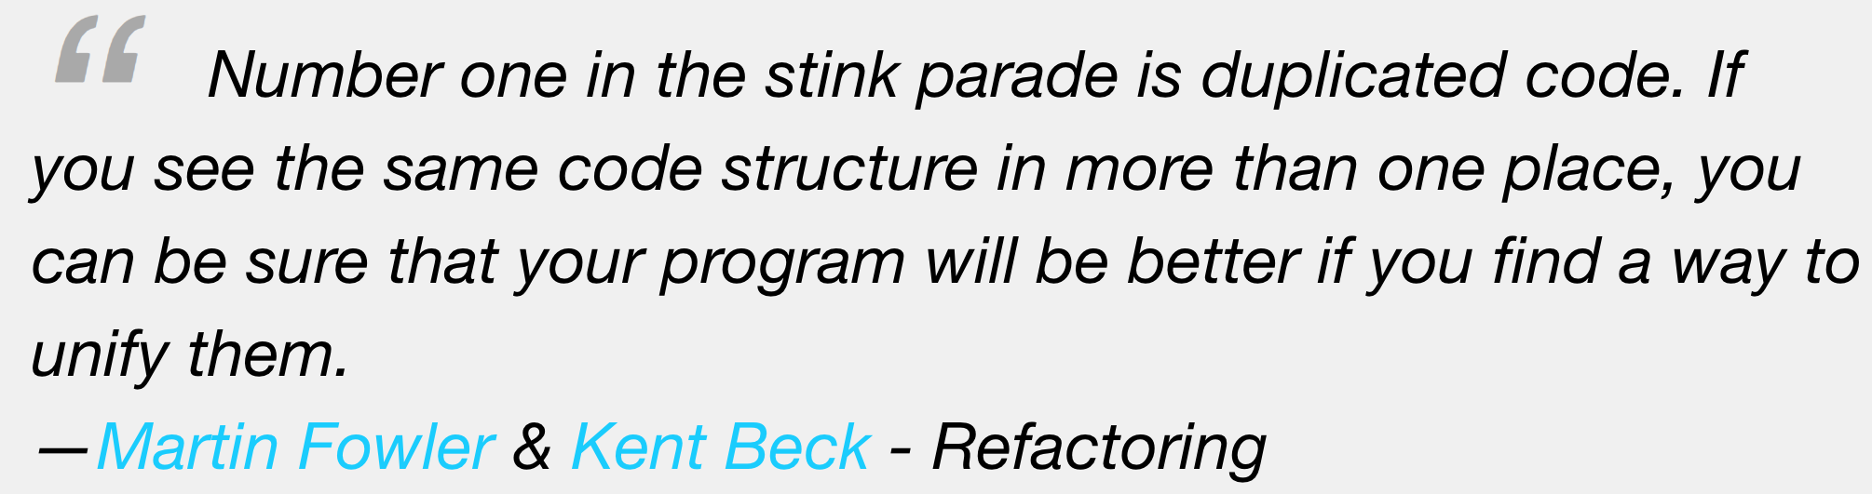

Slide 3
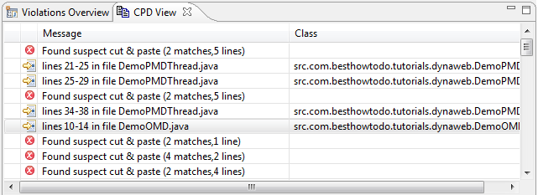

Slide 4
RQ1.
How can we define clone types such that they can be automatically refactored?
RQ2.
What are the discriminating factors to decide when a clone should be refactored?

Slide 5
Clone types
How can we automatically refactor different types of clones?
Type 1. Identical code fragments except for variations in whitespace (may be also variations in layout) and comments.
Notes:
These types have shortcomings when looking at what we can and should refactor.
Type 1 is textual equality except for whitespace and comments.
Type 2 is structurally equal code.
Type 3 allows any variability. Most tools implement this with some notion of similarity.
Type 4 is out of scope.
There are a lot of studies that implement clone detection tools to detect these types of clones. For most tools, the main point of focus is effe
A higher type of clone means that it's harder to detect. It also makes the clone harder to refactor, as more transformations would be required. Higher clone types also become more disputable whether they actually indicate a harmful antipattern (not every clone is harmful). Type 1 clones are most often, if not always with the right thresholds, harmful. Type 2 and type 3 clones are more disputable whether they are harmful and whether they can be merged in a way that improves the design of the code.
5

Slide 6
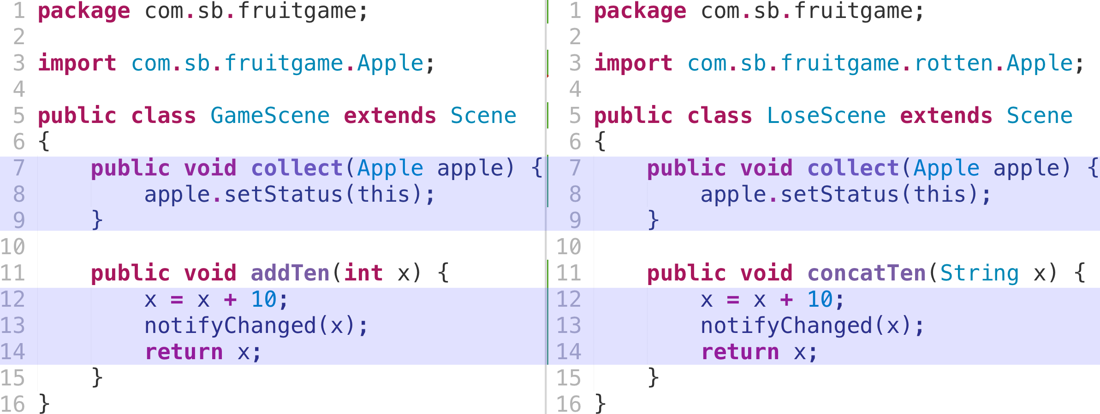
Shortcomings type 1
Textually equal code fragments
Notes:
6

Slide 7
Shortcomings type 1
Textually equal code fragments
Notes:
7

Slide 8
Type 1R clones
Functionally + textually equal code fragments
Compare fully qualified identifier (FQI) of:
Type references
Apple → com.sb.Apple
Method signatures
eat(apple) → com.sb.Waste com.sb.EatController.eat(com.sb.Apple)
Compare FQI of the types of variables
myApple → (com.sb.Apple)myApple
Notes:
8

Slide 9
Clone types
How can we automatically refactor different types of clones?
Type 1. Identical code fragments except for variations in whitespace (may be also variations in layout) and comments.
Type 2. Structurally/syntactically identical fragments except for variations in identifiers, literals, types, layout and comments.
Notes:
These types have shortcomings when looking at what we can and should refactor.
Type 1 is textual equality except for whitespace and comments.
Type 2 is structurally equal code.
Type 3 allows any variability. Most tools implement this with some notion of similarity.
Type 4 is out of scope.
There are a lot of studies that implement clone detection tools to detect these types of clones. For most tools, the main point of focus is effe
A higher type of clone means that it's harder to detect. It also makes the clone harder to refactor, as more transformations would be required. Higher clone types also become more disputable whether they actually indicate a harmful antipattern (not every clone is harmful). Type 1 clones are most often, if not always with the right thresholds, harmful. Type 2 and type 3 clones are more disputable whether they are harmful and whether they can be merged in a way that improves the design of the code.
9

Slide 10
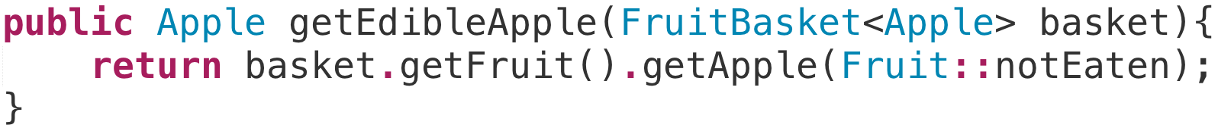
Shortcomings type 2
Type 2 clones allow any(!) variation in identifiers, literals and types(!)
Notes:
TRADEOFFS!!!
10

Slide 11
Type 2R clones
All about design tradeoffs
No design tradeoff
Class/enum/interface names
Method names
Variable names (sometimes)
Design tradeoffs
Literals
Variable references
Called methods
Notes:
11

Slide 12
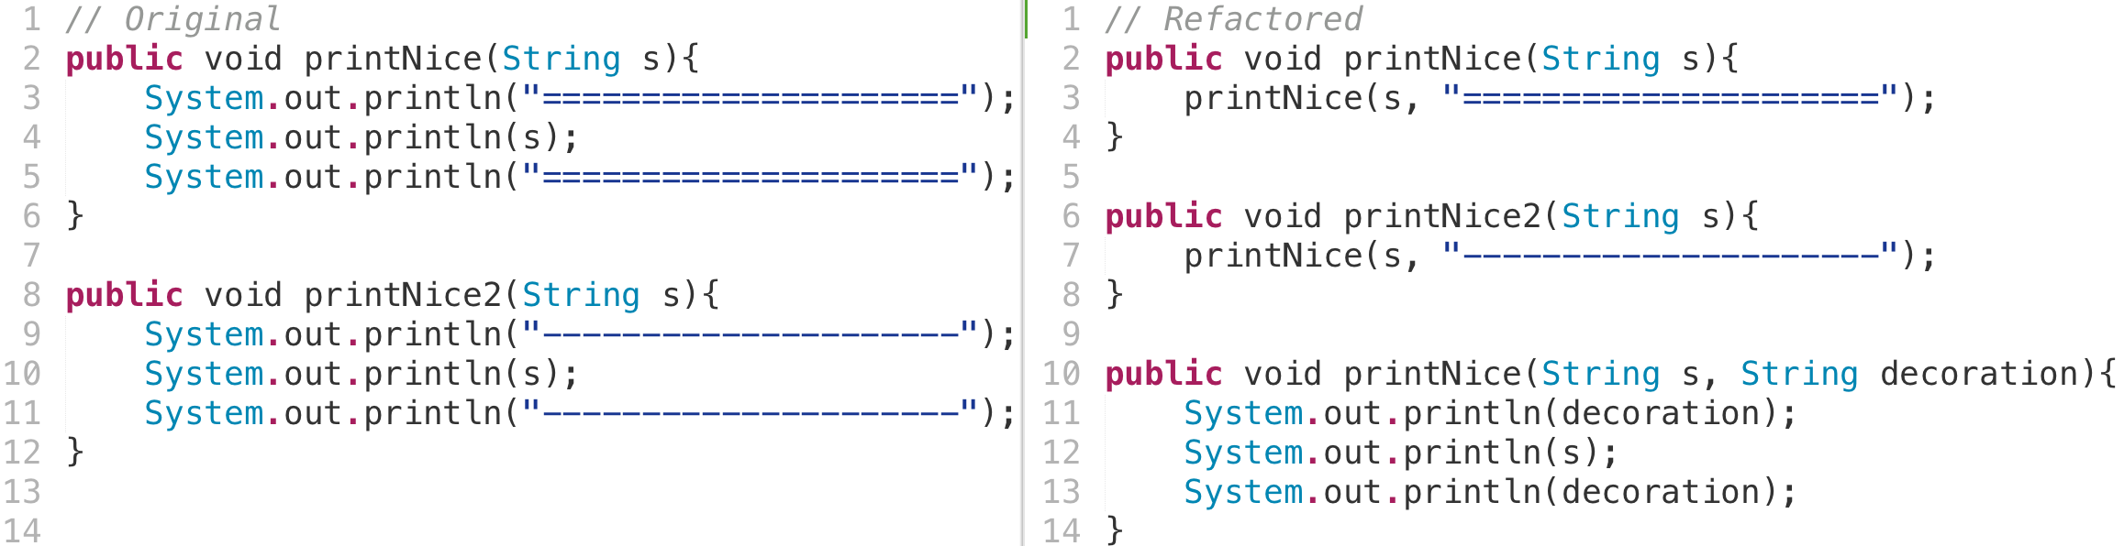
Type 2R clones
Tradeoff: different literal creates extra parameter
Notes:
12

Slide 13
Clone types
How can we automatically refactor different types of clones?
Type 1. Identical code fragments except for variations in whitespace (may be also variations in layout) and comments.
Type 2. Structurally/syntactically identical fragments except for variations in identifiers, literals, types, layout and comments.
Type 3. Copied fragments with further modifications. Statements can be changed, added or removed in addition to variations in identifiers, literals, types, layout and comments.
Notes:
These types have shortcomings when looking at what we can and should refactor.
Type 1 is textual equality except for whitespace and comments.
Type 2 is structurally equal code.
Type 3 allows any variability. Most tools implement this with some notion of similarity.
Type 4 is out of scope.
There are a lot of studies that implement clone detection tools to detect these types of clones. For most tools, the main point of focus is effe
A higher type of clone means that it's harder to detect. It also makes the clone harder to refactor, as more transformations would be required. Higher clone types also become more disputable whether they actually indicate a harmful antipattern (not every clone is harmful). Type 1 clones are most often, if not always with the right thresholds, harmful. Type 2 and type 3 clones are more disputable whether they are harmful and whether they can be merged in a way that improves the design of the code.
13

Slide 14
Shortcomings type 3
How to refactor if anything can change
Copied fragments: how to determine statically.
Ambiguous definition
Most tools use similarity score
Notes:
Definition is not so “static code analysis” friendly.
Type 3 clones allow added, removed and changed statements. This means basically anything can change. Most tools use a similarity threshold to see which type 3 clones should be considered.
14

Slide 15
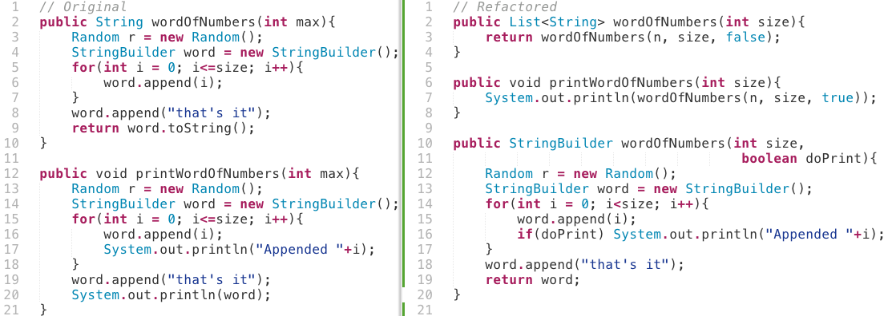
Type 3R clones
Gapped Statements
Notes:
15

Slide 16
Type 3R clones
Added/removed/changed statement → solve with conditional
Notes:
16

Slide 17
CloneRefactor
Relation, Location, Contents, Refactorability
T1, T2, T3, T1R, T2R, T3R
WIP
Notes:
17

Slide 18
CloneRefactor
Notes:
18

Slide 19
Notes:
19

Slide 20
Notes:
20

Slide 21

Experiments
Corpus with 1.343 Java projects
GitHub projects with relatively high number of forks
Relatively small, averaging 980 statements
Clone Types
Thresholds (WIP)
Context
Refactoring (WIP)
Notes:
21

Slide 22
Token threshold
node = Statement/Declaration

Slide 23
Token threshold
node = Statement/Declaration

Slide 24
Token threshold

Slide 25
Token threshold

Slide 26
Token threshold

Slide 27
Clone Types
Amount of clones found
Performance
Notes:
27

Slide 28
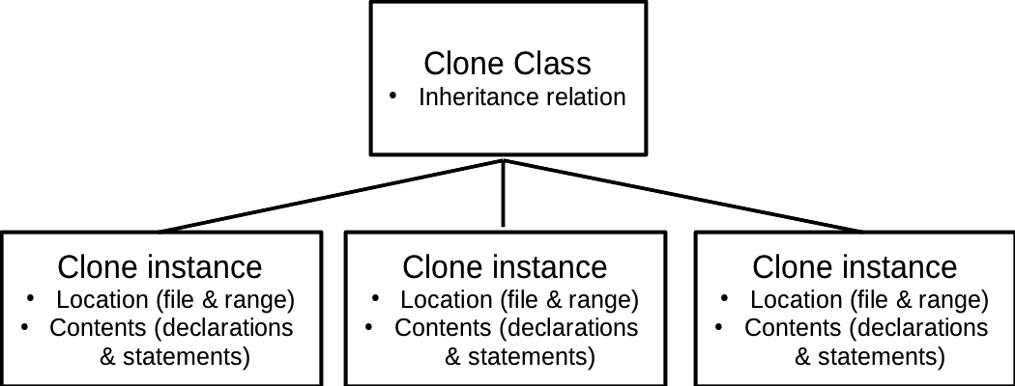
Code Clone Context
How are cloned instances related, where is my clone located and what does my clone contain?
Page 28 of 13
Notes:
To be able to refactor code clones, it is very important to consider the context of the clone. We define the following aspects of the clone as its context:
\item The relation of clone instances among each other (for example: two clone instances in a clone class are part of the same object).
\item Where a clone instance occurs in the code (for instance: a method-level clone is a clone instance that is (a part of) a single method).
\item The contents of a clone instance (for instance: the clone instance consists of a one method declaration, a foreach statement and two variable declarations).
Everything in the context of a clone has a big impact on how it has to be refactored. For this study we performed measurements on the context of clones in a large corpus of open source projects.
28

Slide 29
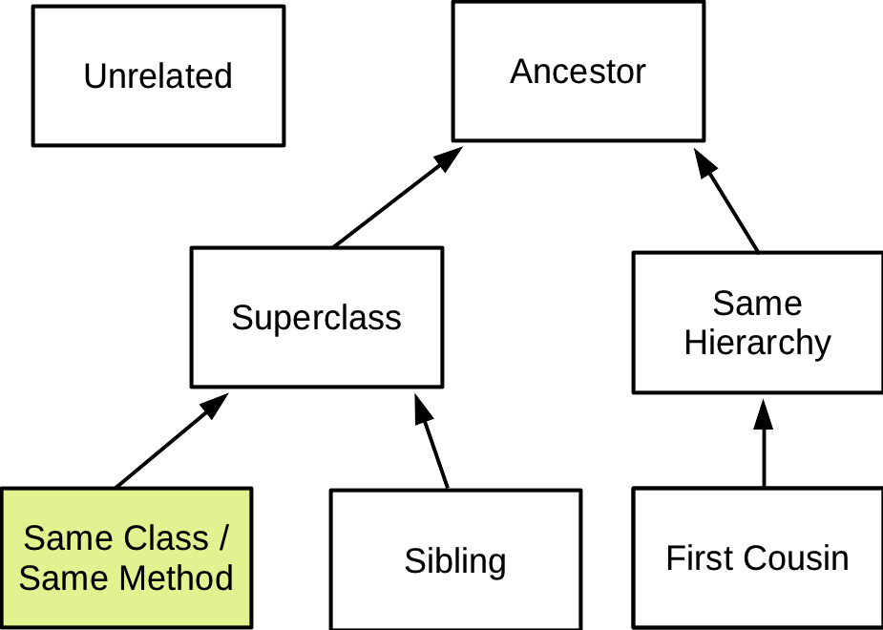
Clone Relations
Relation through inheritance between clone instances
Notes:
We took the categories from an existing study.
We don’t take into account external classes, as they aren’t interesting for refactoring.
We have an extra category that is not modelled here: same external superclass.
29

Slide 30
Relation between clone instances
Notes:
30

Slide 31
Location of clones
Notes:
31

Slide 32
Contents of clones
Notes:
32

Slide 33
Refactorability
To what extend can we extract methods?
Notes:
33

Slide 34
Next steps
Analyze impact of “Extract Method” refactorings
RQ3.
To what extent can we automate the process of refactoring clones?
Analyze Refactored Source Code
Maintainability index
Volume
Duplication
Complexity
Survey
Dynamic Thresholds based on tradeoff
Relation
Number of parameters
Notes:
34

Slide 35
Summary
Refactoring-Oriented clone types
T1R. Textually and functionally identical code fragments.
T2R. Allow change in controlled features of a codebase. Refactoring opportunities for these controlled features are known.
T3R. Allows a gap of different statements between clones, constrained by a threshold.
Refactoring oriented clone types take about 5 times as long to detect and yield fewer clones.
Almost half of all clones are in the same class/method, about 35% is unrelated.
About 80% of clones is found in methods.
Applying refactorings will be a goldmine for threshold related information.

